Slide 1
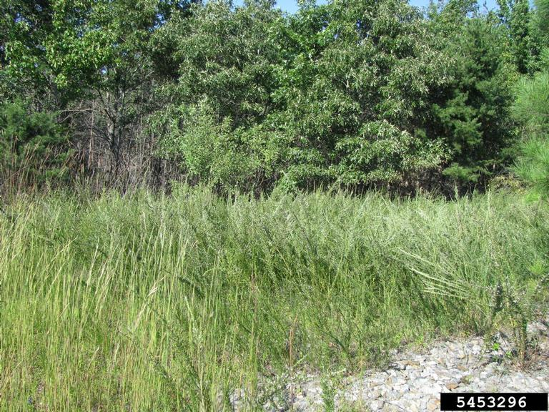
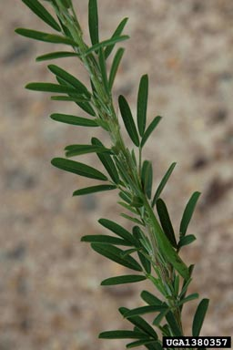
BE AWARE!
Lespedeza cuneata
A threat to the EPPO region
How to recognize it? Can you help us?
Lespedeza cuneata is a long-lived perennial or subshrub, growing to a height of 0.5-1 m. The plant produces trifoliate leaves along the entire stem. Stems can be coarse or fine, depending on the cultivar. Leaflets are long, narrow, and indented at the end; one of the key features that has been used to distinguish L. cuneata from L. juncea.
Because Lespedeza cuneata has the potential to impact the habitats it invades, including native plant species and important ecosystem services, it is important to report any sightings to plant protection authorities. Early detection will allow a rapid implementation of appropriate measures against Lespedeza cuneata.
If you see Lespedeza cuneata:
Check the identification of the species with other legume like species.
Whenever possible, take a picture of the plant, record exact location, date and habitat where it was observed.
Contact us.
Image: Chris Evans, University of Illinois, Bugwood.org
Contact us
Your contact details
Your institution name
Logo
Image: Chris Evans, University of Illinois, Bugwood.org
This leaflet has been prepared within the LIFE funded project LIFE15 PRE FR 001 in collaboration with the NERC Centre for Ecology and Hydrology
Prepared in collaboration with EPPO – www.eppo.int

Slide 2
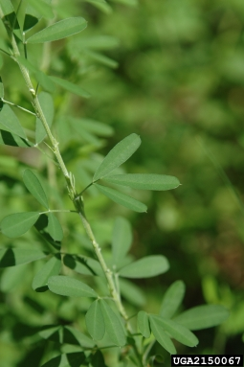
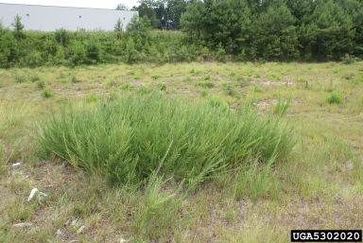
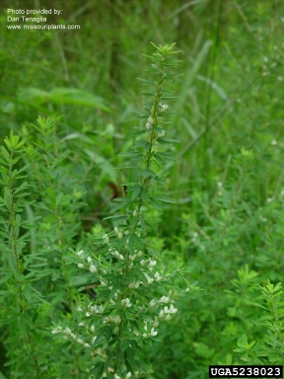
What is L. cuneata? What is the problem? Where is it found?
Lespedeza cuneata is an erect or sub-erect perennial herbaceous legume native to Asia.
As Lespedeza cuneata is considered to be a threat to native biodiversity, its appearance in new areas should be reported immediately to us.
Lespedeza cuneata can thrive under a variety of conditions, crowding out native species in natural areas. The species forms dense stands in areas where it invades, reducing light availability and potentially increasing competition for soil water. Invasions into oak savannas in southeastern Kansas (US) have reduced native plant species richness and reduced the abundance of invertebrate species. L. cuneata may also have impacts on native plant communities through allelopathic effects. Allelopathic chemicals have been found to reduce native grass species’ performance by up to 60%.
The species is currently absent from the natural environment in the EPPO region.
Throughout its invasive range, the species invades habitats such as grassland, woodland, forests, edges of wetlands, pastures, and disturbed sites. The species may be grown on a small scale and available from horticultural suppliers in the EPPO region. The species is also utilised as a forage species outside of the EPPO region and could be imported into the region for this purpose in the search for new protein plants in the future.
Image: Chris Evans, University of Illinois, Bugwood.org
Image: Chuck Bargeron, University of Georgia, Bugwood.org
Image: Dan Tenaglia, Missouriplants.com, Bugwood.org

